Slide 1
Assignment 2
Group members:
Zeyuan Wang
Jiawen Wu

Slide 2
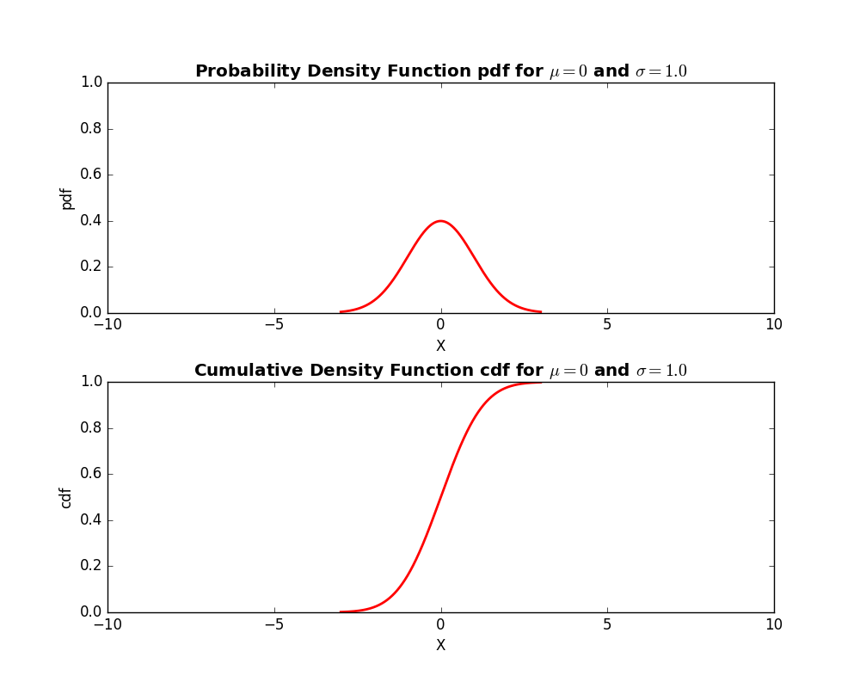
The PDF plot from slide 20, along with CDF attached

Slide 3
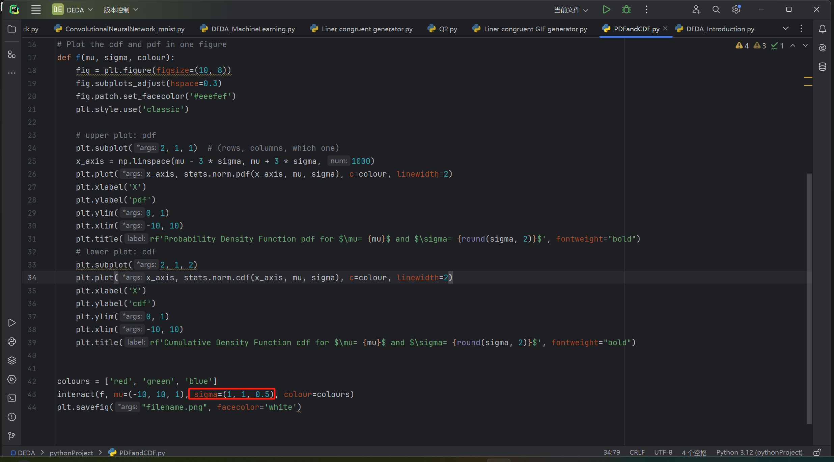
Core code

Slide 4
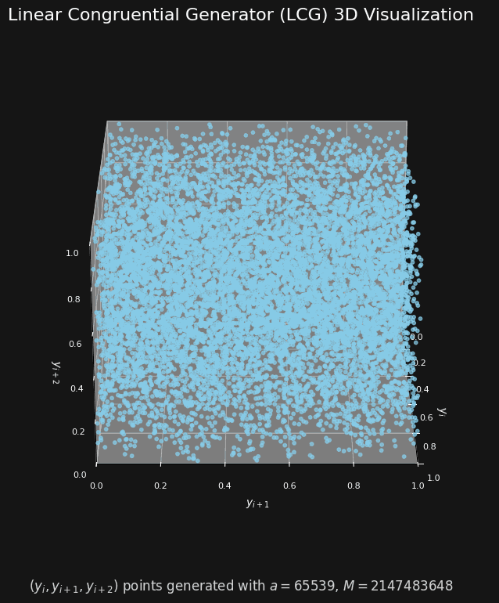
N(mu,SIGMA) in a rotating plot
Attached:
3D scatter plot generated by Liner congruent

Slide 5
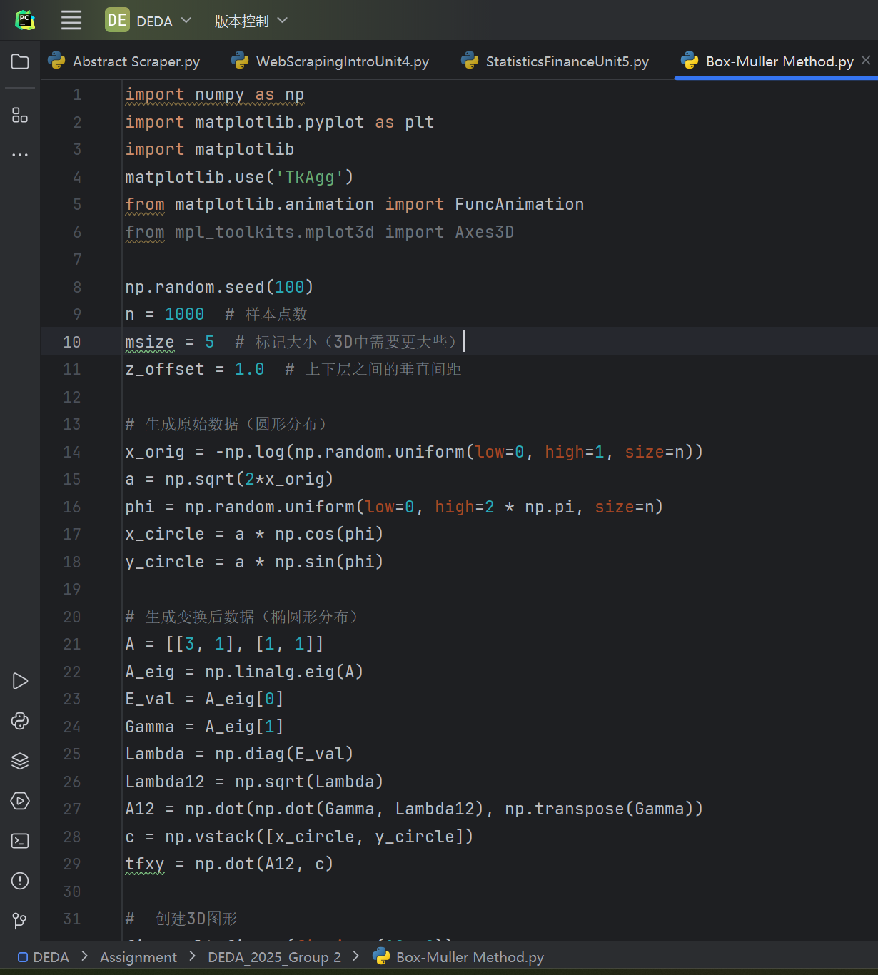
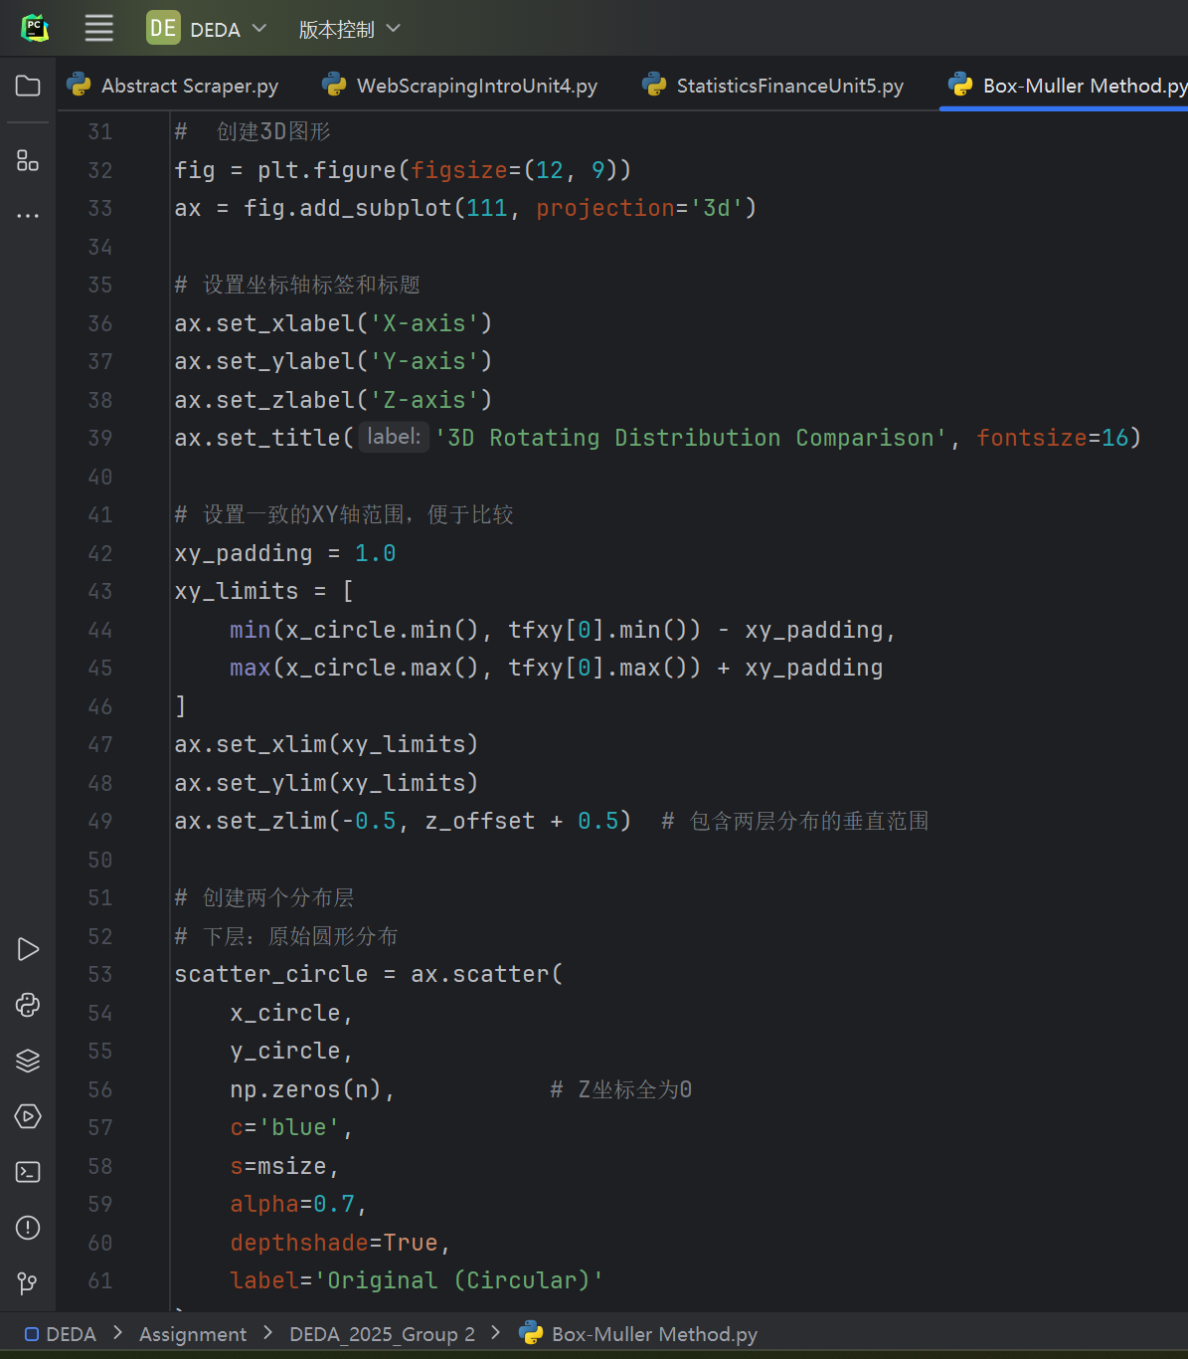
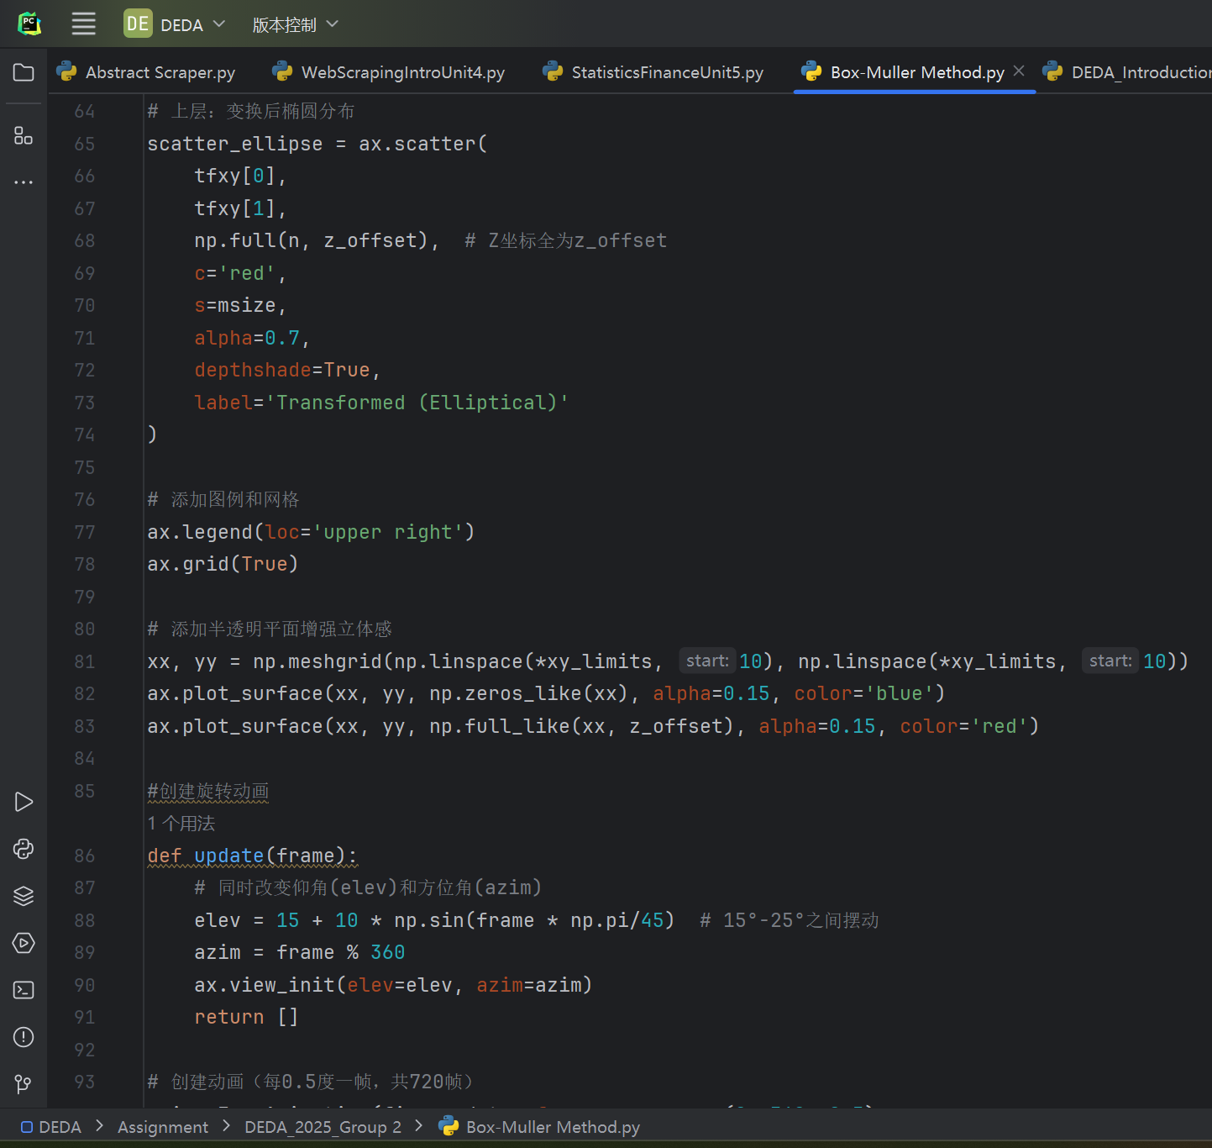
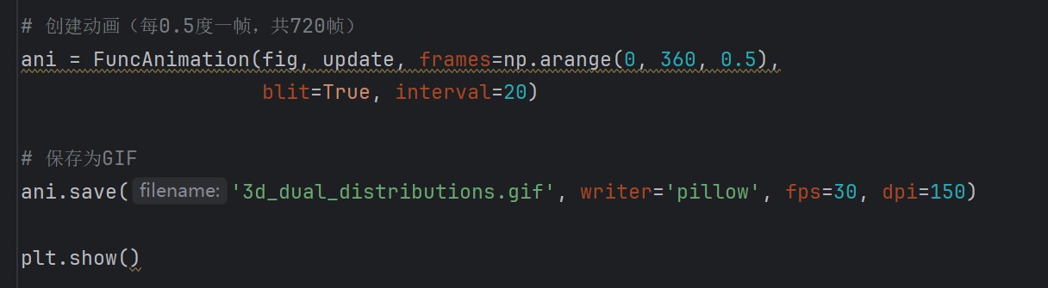
Core code

Slide 6
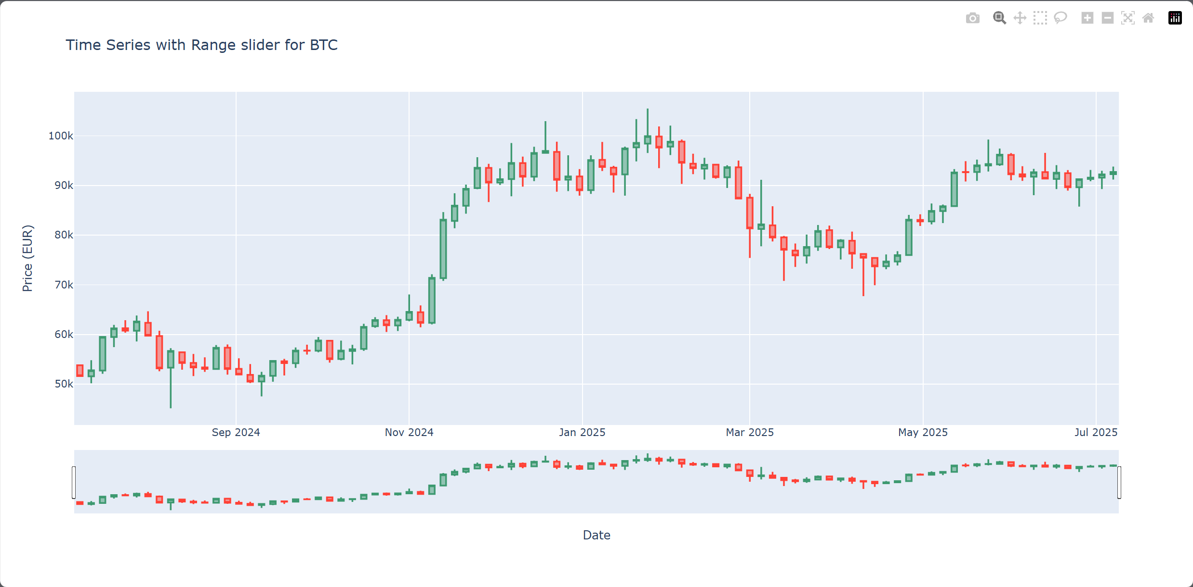
The slider plot for BTC

Slide 7
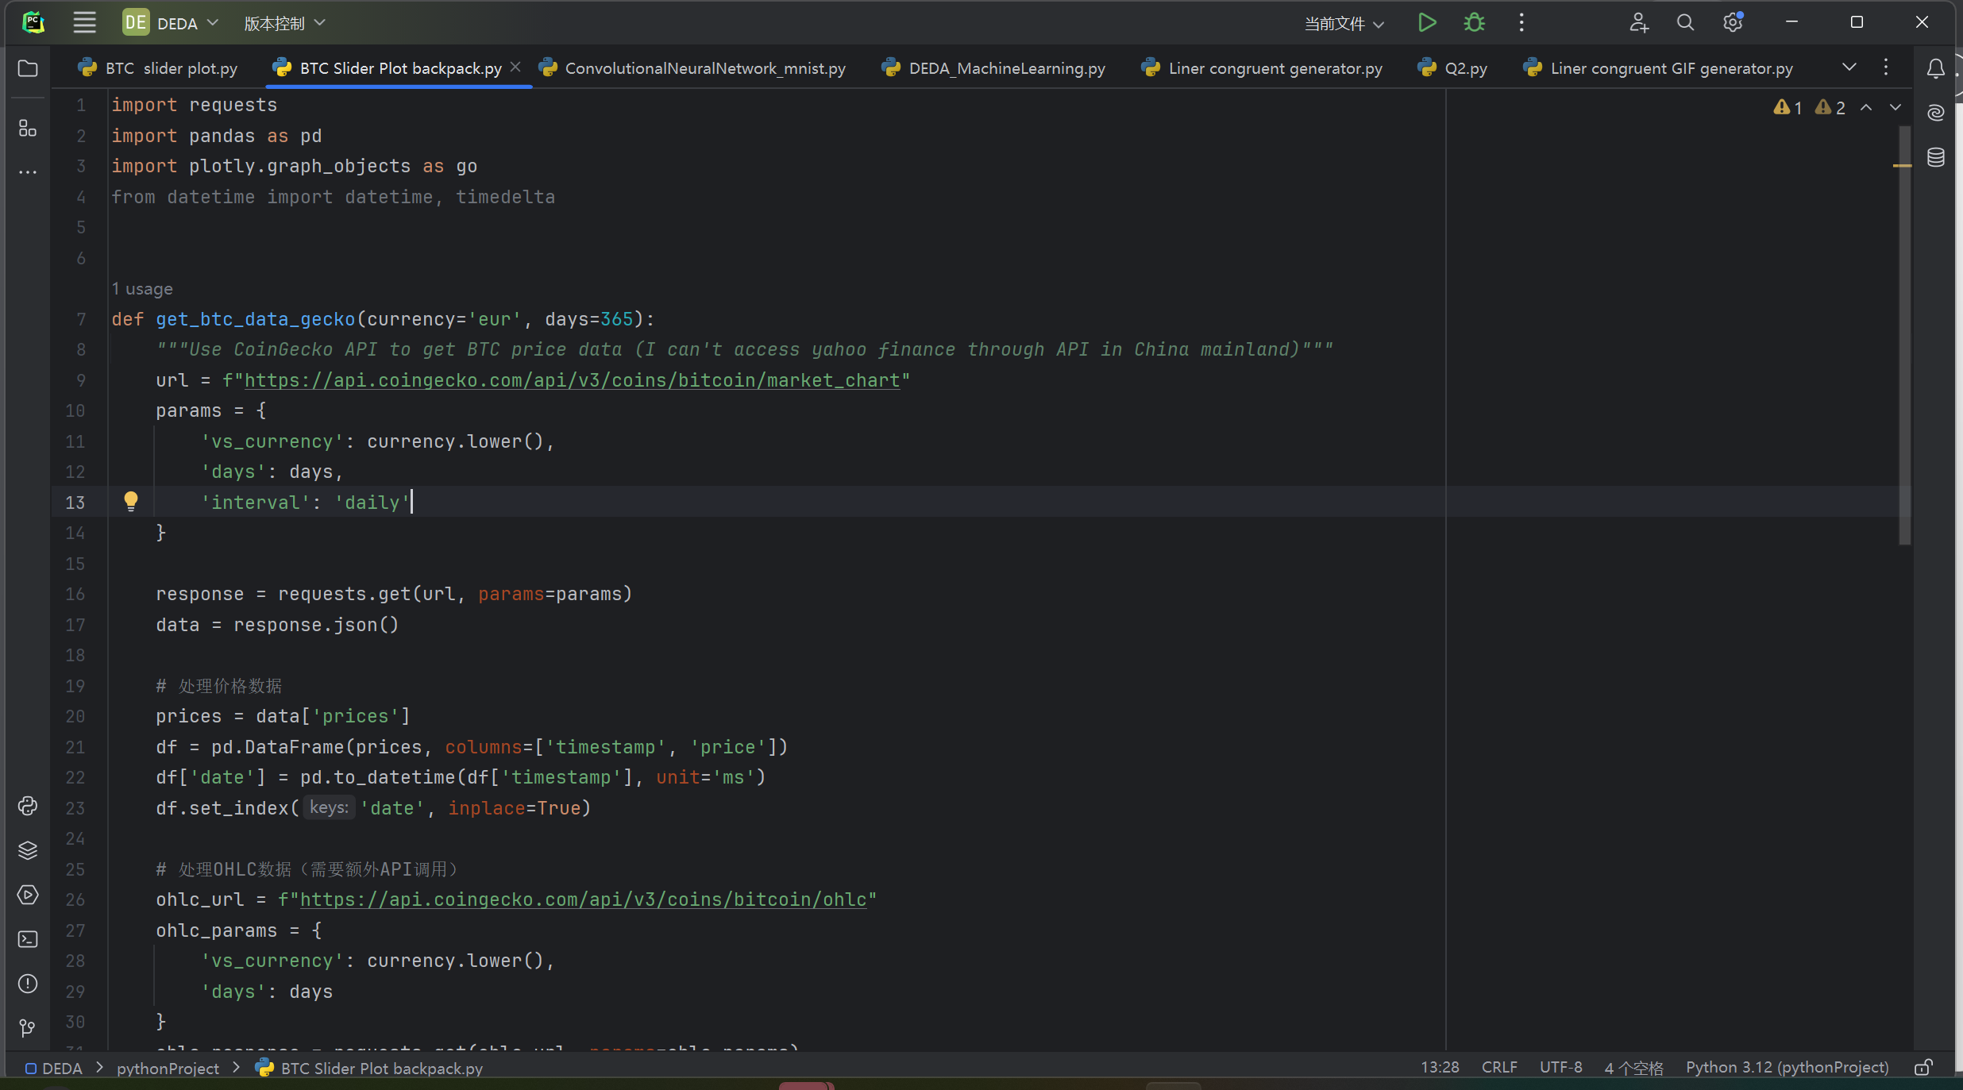
Core code

Slide 8
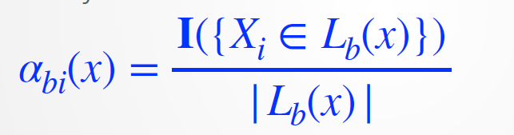
A Random forest example
Scenario: Predicting diabetes risk (Yes/No) using patient data.
Age | BMI | Glucose | Diagnosis
45 | 25 | 110 | No
60 | 32 | 140 | Yes
50 | 28 | 125 | X (Test point)
Suppose the forest has 3 trees:
​Tree 1: Test point lands in a leaf with:
Patient 1 (Diagnosis = No) → Weight = 1/1=1
Patient 2 not in leaf → Weight = 0
α₁₁​(X)=1, α₁₂​(X)=0
​Tree 2: Leaf contains:
Patient 2 (Diagnosis = Yes) → Weight = 1/1=1​
α₂₁​(X)=0, α₂₂​(X)=1
​Tree 3: Leaf contains both patients → Weight = 1/2​ each
α₃₁​(X)=0.5, α₃₂​(X)=0.5

Slide 9
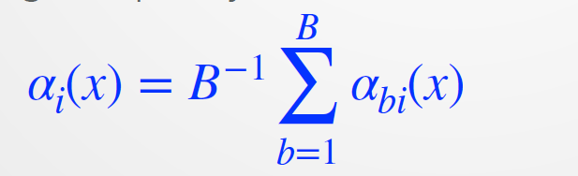
A Random forest example
Scenario: Predicting diabetes risk (Yes/No) using patient data.
Age | BMI | Glucose | Diagnosis
45 | 25 | 110 | No
60 | 32 | 140 | Yes
50 | 28 | 125 | X (Test point)
​Final Effective Weights:
α₁(X)=(1+0+0.5)/3=0.5, α₂ (X)=(0+1+0.5)/3=0.5
​Prediction: 50% probability of diabetes → ​Ambiguous case​ (needs further tests).

